Slide 1
Using Bone Measurements
to Cluster Birds into
Ecological Groups
Erin Burns

Slide 2
Overview
8 ecological groups of birds
Swimming Birds
Wading Birds
Terrestrial Birds
Raptors
Scansorial Birds
Singing Birds
Cursorial Birds (not included in dataset)
Marine Birds (not included in dataset)
Living habits of birds reflected by differences in bone sizes

Slide 3
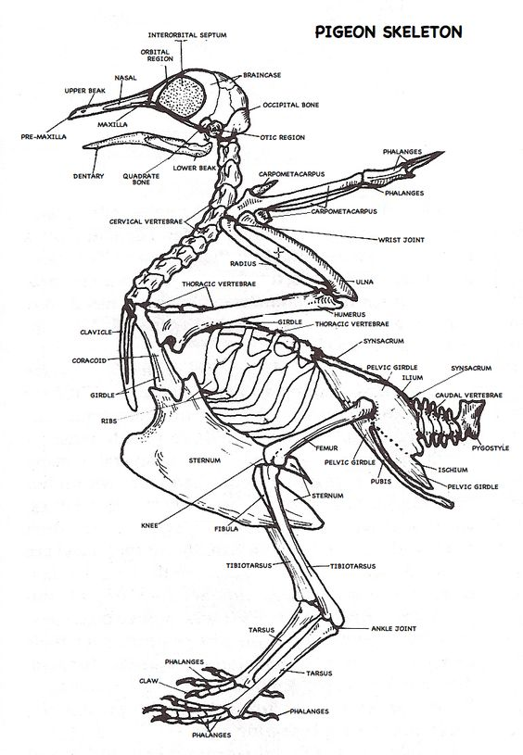
Data Analyzed
10 bone measurements from 420 birds
Raw data available here: https://www.kaggle.com/datasets/zhangjuefei/birds-bones-and-living-habits

Slide 4
Project Goals
Research question:
Can birds be classified into ecological groups based solely on bone measurements?
Direct observation of birds often time consuming and difficult
Direct observation of extinct species not possible
Using ML gives info on living habits without direct observation

Slide 5
Dataset Exploration
Some null values to address
Variables all have similar distributions
Some imbalance in the target variable distribution
Strong correlation between variables
A lot of overlap between measurements for birds from different ecological groups

Slide 6
Data Preprocessing
Ensure clean data
Evaluated outliers, examined variables for potential errors
Missing or incomplete data
A few null values, dropped rows with null values
Preparing data for analysis
Removed ID column
Transformed ‘type’ data into numeric (0-5) from group name abbreviations

Slide 7
Dimensionality Reduction Process Overview
Overview of methods used
PCA
t-SNE
UMAP
Method / Evaluation
Tuned hyperparameters
Evaluated whether representations showed distinct clusters with labeled and unlabeled data

Slide 8
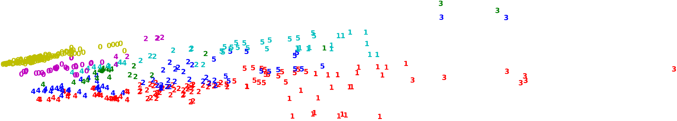
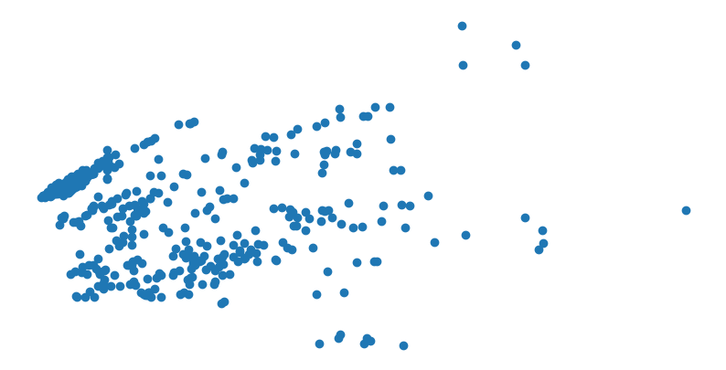
Method 1: PCA
Groups in layered lines
Lots of overlapping
Groups sort of visible but not very distinct on unlabeled scatter

Slide 9
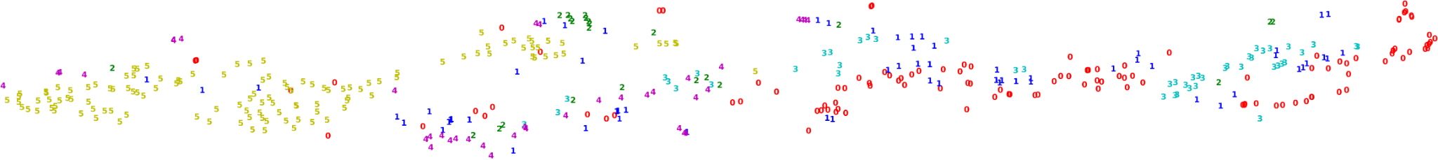
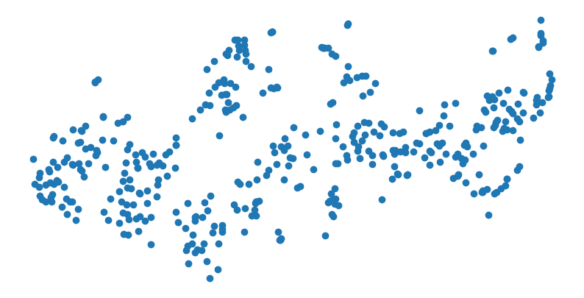
Method 2: t-SNE
Some groups of same-class data
Lots of overlap
Unlabeled graph shows somewhat distinct groups, but is misleading

Slide 10
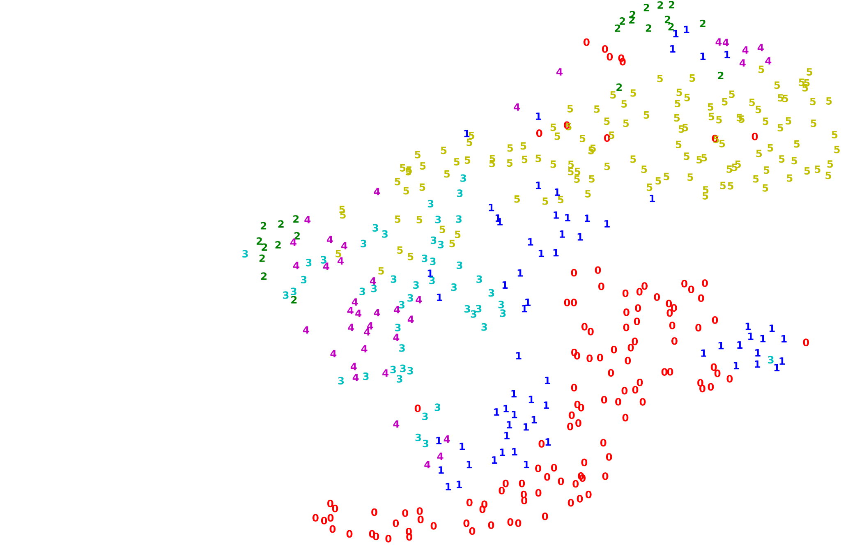
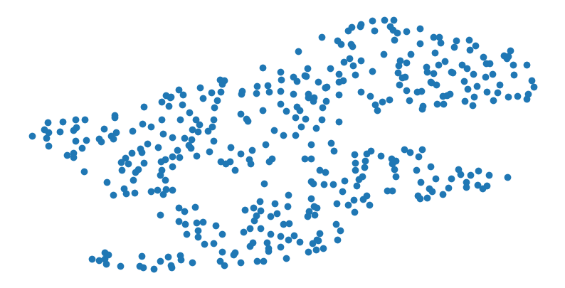
Method 3: UMAP
Can see some defined groupings
Overlap between groups
Multiple small groups of same class
Unlabeled graph looks like two large clusters

Slide 11
Clustering Process Overview
Overview of algorithms used
K-means
DBSCAN
Hierarchical Clustering
Gaussian Mixture Models (GMM)
Data Processing
Used PCA transformed data
Tuned hyperparameters individually
Evaluation methods
ARI and silhouette scores

Slide 12
Algorithm 1: K-means
ARI score: 0.4272
Silhouette score: 0.3813
Strengths: Decent scores
Weaknesses: Does not meet k-means assumptions

Slide 13

Algorithm 2: DBSCAN
Strengths: Identified a couple distinct clusters (yellow and pink)
Weaknesses: Majority of points labeled as noise
ARI score: 0.3547
Silhouette score: 0.3328

Slide 14
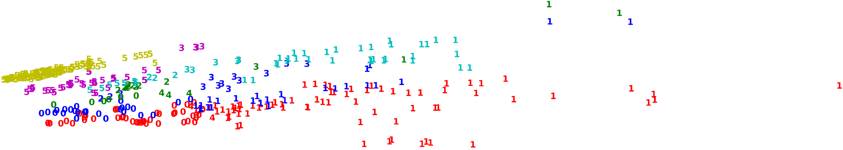
Algorithm 3: Hierarchical Clustering (complete)
Strengths: Higher score for correct assignments
Weaknesses: Lots of groups assigned across true classes, Multiple distinct clusters assigned to same group
ARI score: 0.4503
Silhouette score: 0.2071

Slide 15
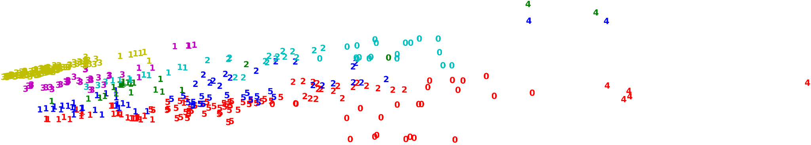
Algorithm 3: Hierarchical Clustering (ward)
Strengths: Decent scores
Weaknesses: Lots of groups assigned across true classes, Multiple distinct clusters assigned to same group
ARI score: 0.3951
Silhouette score: 0.3569

Slide 16
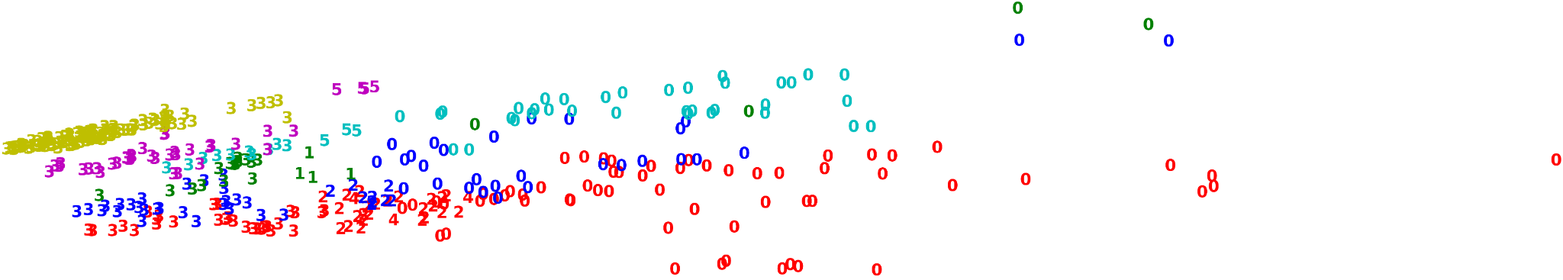
Algorithm 3: Hierarchical Clustering (average)
ARI score: 0.2134
Silhouette score: 0.1661
Strengths: N/A
Weaknesses: Poor scores, many points assigned to just two groups

Slide 17

Algorithm 3: Hierarchical Clustering (single)
ARI score: 0.0028
Silhouette score: -0.3474
Strengths: N/A
Weaknesses: All points except for a couple in same group

Slide 18

Algorithm 4: Gaussian Mixture Models
ARI score: 0.4345
Silhouette score: 0.3165
Strengths: Decent scores
Weaknesses: Assigned clusters are not very distinctly shaped, Overlap

Slide 19
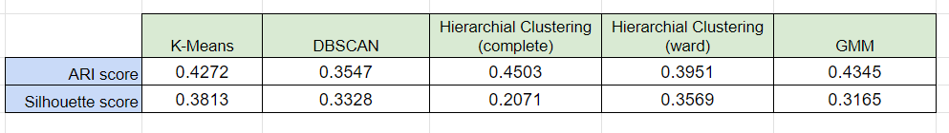
Algorithm Comparison
Hierarchical ‘complete’ had highest ARI score
K-Means had highest silhouette score

Slide 20
Conclusions
Can birds be classified into ecological groups solely based on bone measurements?
Current models not able to group birds based on bone measurement data
Similarly sized birds in different ecological groups
More data required
Future directions:
Adding additional variables to dataset
Data on diet or geographical distribution

Slide 21
Questions?

